Slide 1
IOT CONTROL AGRICULTURE VECHILE
PROJECT TEAM

Slide 2
SYNOPSIS
Here we are fabricating the agriculture machine is a new innovative model which is mainly used to water spraying, seed sowing. Our main aim of this concept is to reduce the man power and also avoid time consumption and to utilize solar energy. The entire assembly is controlled by app which is made on IOT app maker and the brain of this project is the Arduino Uno which controls all the motors and pump by receiving signals from the app with help of a wifi module (ESP8266), Arduino stores the code which is encoded into it by Arduino encoder. Entire assembly is moved by motors.

Slide 3
INTRODUCTION
Agriculture in India dates back to Indus Valley Civilization Era and even before that in some parts of Southern India. Today, India ranks second worldwide in farm output. The special vehicles plays a major role in various fields such as industrial, medical, military applications etc., The special vehicle field are gradually increasing its productivity in agriculture field. Some of the major problems in the Indian agricultural are rising of input costs, availability of skilled labour, lack of water resources and crop monitoring. To overcome these problems, the automation technologies were used in agriculture. The automation in the agriculture could help farmers to reduce their efforts. The vehicles are being developed for the processes for weeding, seed sowing, levelling and water spraying. All of these functions have not yet performed using a single vehicle. In this the robots are developed to concentrate in an efficient manner and also it is expected to perform the operations autonomously. The proposed idea implements the vehicle to perform the functions such as ploughing, seed sowing, mud leveling and water spraying. These functions can be integrated into a single vehicle and then performed.

Slide 4
NEED FOR AUTOMATION:
Nowadays almost all the manufacturing process is being atomized in order to deliver the products at a faster rate. The manufacturing operation is being atomized for the following reasons.
To achieve mass production
To reduce man power
To increase the efficiency of the plant
To reduce the work load
To reduce the production cost
To reduce the production time
To reduce the material handling
To reduce the fatigue of workers
To achieve good product quality
Less maintenance

Slide 5
FUTURE SCOPE
By increasing the equipment strength and quality to its peak, we can have multipurpose agricultural equipment for life time usage. By providing hydraulics, gear arrangements and some minor adjustments the equipment can also be made as tractor powered equipment

Slide 6
LITERATURE REVIEW
Agriculture refers to the production of food and goods through farming and forestry. Agriculture was the key development that led to the rise of civilization; with the husbandry of domesticated animals and plants (i.e. crops) creating food surpluses that enabled the development of more densely populated and stratified societies. The study of agriculture is known as agricultural science.

Slide 7
AGRICULTURE IN INDIA
Agriculture in India has a long history dating back to ten thousand years.
Today, India ranks second worldwide in farm output. Agriculture and allied sectors like forestry, logging and fishing accounted for 16.6% of the GDP in 2007, employed 60% of the total workforce[1] and despite a steady decline of its share in the GDP, is still the largest economic sector and plays a significant role in the overall socio-economic development of India.
India is the largest producer in the world of milk, cashew nuts, coconuts, tea, ginger, turmeric and black pepper. It also has the world's largest cattle population (281 million). It is the second largest producer of wheat, rice, sugar, groundnut and inland fish. It is the third largest producer of tobacco. India accounts for 10% of the world fruit production with first rank in the production of banana and sapota. India's population is growing faster than its ability to produce rice and wheat.

Slide 8
PROBLEMS IN AGRICULTURE
Slow agricultural growth is a concern for policymakers as some two-thirds of India’s people depend on rural employment for a living. Current agricultural practices are neither economically nor environmentally sustainable and India's yields for many agricultural commodities are low. Poorly maintained irrigation systems and almost universal lack of good extension services are among the factors responsible. Farmers' access to markets is hampered by poor roads, rudimentary market infrastructure, and excessive regulation.

Slide 9
REVIEW
M.V. Achutha [1] This research paper provides information regarding the design and analysis of a multipurpose farm equipment which can perform operations such as sowing , inter cultivation , spraying for small scale farmers without huge investment and can be operated manually without any external source of energy .
Nitin Kumar Mishra [2] Here the author has suggested a development of a multipurpose agricultural machine which is easy in construction and areeconomical as it runs on solar energy.
P. Vijay [3] This paper describes a machine which has better and effective design and can be used specifically for rice , wheat crops ,etc.
D.A. Mada [4] In this paper author has tried to prove the importance of mechanization in agriculture by giving certain examples. The paper concluded the need of multifunctional single axel vehicle for pre and post harvesting.

Slide 10
MACHINE COMPONENTS
The IOT CONTROL AGRICULTURE VECHILE is consists of the following components to full fill the requirements of complete operation of the machine.
1. Motor -02 qty
2. Battery
3. Dc pump
4. Nozzle
5. Switch
ESP8266 WIFI

Slide 11
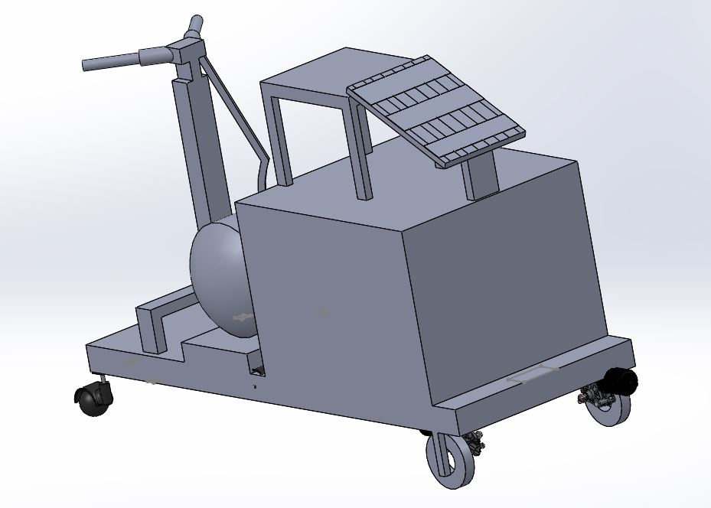
DRAWING FOR IOT CONTROL AGRICULTURE VECHILE

Slide 12
WORKING PRINCIPLE
In our project all the components are placed on the base frame. There are four wheels to move this machine. The spraying nozzle is coupled with the motor to spray for moving the nozzle. Then the water is pumped from the water tank to the sprayer nozzle. The hopper and the motor setup is used for sowing the seeds. Seed sprayer set up consists of four pipes around the main in right angle to each other. The seed sprayer is used for spraying the seeds over the land. All motors are taken the energy from the storage battery. The battery is charged by the sun light by using the solar panel which is attached in this vehicle. After all the motors are switched ON, then the vehicle can be moved by remote control over the agricultural field.

Slide 13
MERITS & DEMERIT
MERITS
Low cost
Easy to operate
Usage of solar energy
Low power consumption
Reduced man power
DEMERIT
Solar power is not available at night time.

Slide 14
APPLICATIONS
It can be used by all farmers such that they avoid diesel sprayers and without any maintenance cost, they can use it.

Slide 15
CONCLUSION
The project carried out by us made an impressing task in the field of agricultural sector. The multi utility agricultural machine is very usefully for the workers to carry out a number of operations in a single machine. Practically our multi utility agricultural machine can be used for seed sowing, ploughing and also used for water spraying. All the parts are arranged in such a way that in every stage of agriculture, the equipment can be rearranged to perform the specified action. Our team has successfully combined many ideas from various fields of mechanical engineering and agricultural knowledge to improve the yield and by reducing the labour effort and expenses. The whole idea about multipurpose equipment is a new concept, patentable and can be successfully implemented in real life situations. More operations can be included to the vehicle like soil leveler, grass cutter and many other machines for various operations. Also engine can be used to drive the equipment which will reduce the work load. The tyre can be changed according to the type of the land. The plough tool tip arrangement is made separately, so in case of breakage the tip of the tool is alone changed. A steering mechanism can also be done for the ease
Of control.

Slide 16
REFERENCES
1. M.V. Achutha, Sharath Chandra.N.,Natraj .G.K “Design and analysis of multipurpose farm equipment” IJIRAE ISSN:2349-2763 Issue 02,Vol.3 (Feb.2016)
2. Nitin Kumar Mishra , Shaswat Khare , Sumit Singh “Multi-purpose Agricultural Machine” ISSN:2321-9009 Vol.5,ISS-1,Spl. Issue -2 Feb-2017
3. P. Vijay , K.V.N.Rakesh, B. Varun, “Design of a Multi purpose seed sower cum plougher” IJETAE , ISSN 2250- 2459 Vol.3,Issue-4, Apr-2013
4. D.A. Mada, Sunday Mahai, “The Role of Agricultural Mechanization in the Economic Development for Small Scale Farms In Adamawa State”,The International Journal Of Engineering And Science (IJES) Volume 2, Issue 11, Pages 91-96 , 2013 , ISSN (e): 2319 – 1813 ISSN(P): 2319- 1805 – Nov-2013
5. V.K. Tewari, A. Ashok Kumar, Satya Prakash Kumar, Brajesh Nare, “Farm mechanization status of West Bengal in India”, Basic Research Journal of Agricultural Science and Review ISSN 2315 6880 Vol. 1(6) pp. 139-146 Dec-2012

Slide 17
THANKING YOU

